Slide 1

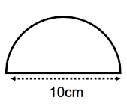
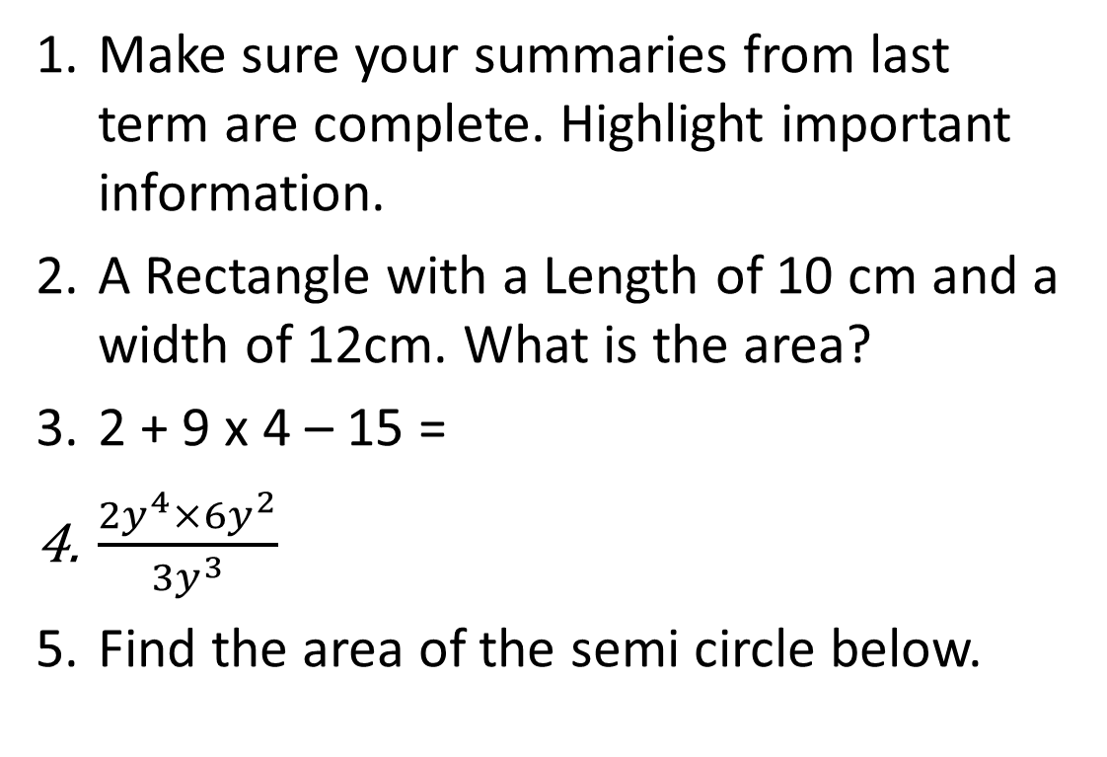
Have a go at these questions:
Topic: Simplifying Ratios EQ: How do you simplify ratios?
Make sure your summaries from last term are complete. Highlight important information.
A Rectangle with a Length of 10 cm and a width of 12cm. What is the area?
2 + 9 x 4 – 15 =
$\frac{{2y}^{4}×{6y}^{2}}{{3y}^{3}}$
Find the area of the semi circle below.

Slide 2
Think Pair Share
In a pair create a list ratios that are equivalent to:
Be prepared to share
9 : 12
18 : 24
Notes:
Check for understanding

Slide 3
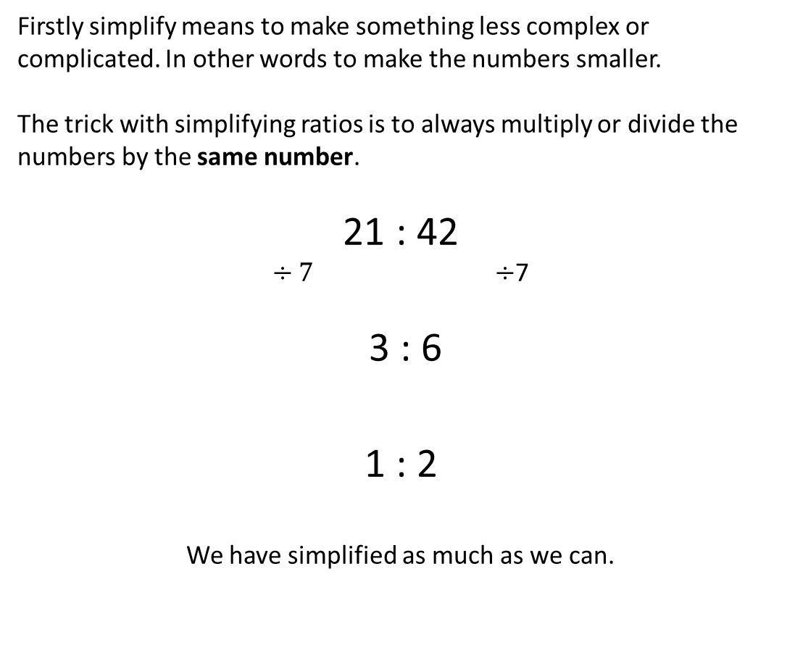

24
7
30
Date
Topic – Simplifying Ratios
EQ: How do you simplify ratios?
What does simplifying ratios look like?
Firstly simplify means to make something less complex or complicated. In other words to make the numbers smaller.
The trick with simplifying ratios is to always multiply or divide the numbers by the same number.
21 : 42
$÷7 ÷$7
3 : 6
1 : 2
We have simplified as much as we can.
$$÷3 ÷3$$
5
Notes:
Lesson objective (EQ)

Slide 4
Guided Practice
Simplify the following ratios? You may need to simplify several times.
48 : 12
63 : 27
16m : 40m
600k : 1800k
7.2 : 3.6
Notes:
Guided practice

Slide 5
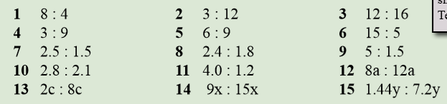
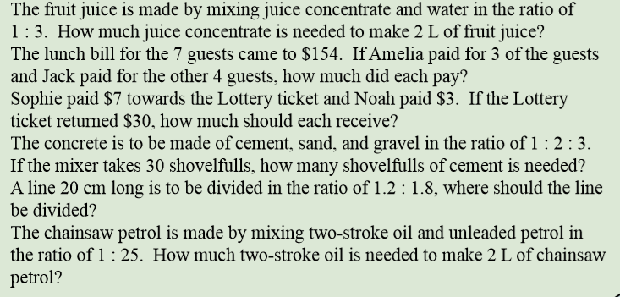
Activity
Practice Simplifying
16.
17.
18.
19.
20.
21.
Notes:
Independent practice

Slide 6
Closure activity
Exit pass – What is the following ratio fully simplified?
35 : 70
Notes:
Closure

